Slide 1
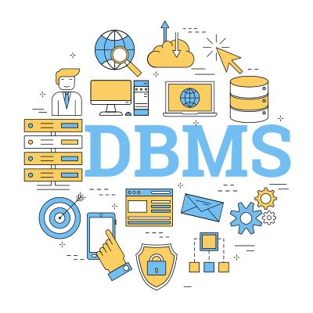
Database Systems Concepts and Design
CSC201S2/G2

Slide 2
Chapter 1: Introduction

Slide 3
Outline
Database-System Applications
Purpose of Database Systems
View of Data
Database Languages
Database Design
Database Engine
Database Architecture
Database Users and Administrators
History of Database Systems

Slide 4
Database Systems
DBMS contains information about a particular enterprise
Collection of interrelated data
Set of programs to access the data
An environment that is both convenient and efficient to use
Database systems are used to manage collections of data that are:
Highly valuable
Relatively large
Accessed by multiple users and applications, often at the same time.
A modern database system manage a large, complex collection of data.
Databases touch all aspects of our lives

Slide 5
Database Applications Examples
Enterprise Information
  Sales: customers, products, purchases
  Accounting: payments, receipts, assets
  Human Resources: Information about employees, salaries, payroll taxes.
Manufacturing: management of production, inventory, orders, supply chain.
Banking and finance
  customer information, accounts, loans, and banking transactions.
  Credit card transactions
  Finance: sales and purchases of financial instruments (e.g., stocks and bonds; storing real-time market data
Universities: registration, grades

Slide 6
Database Applications Examples
Airlines: reservations, schedules
Telecommunication: records of calls, texts, and data usage, generating monthly bills, maintaining balances on prepaid calling cards
Web-based services
  Online retailers: order tracking, customized recommendations
  Online advertisements
Document databases
Navigation systems: For maintaining the locations of varies places of interest along with the exact routes of roads, train systems, buses, etc.

Slide 7
Purpose of Database Systems
Data redundancy and inconsistency
Difficulty in accessing data
Data isolation
Integrity problems
  Integrity constraints (e.g., account balance > 0) become “buried” in program code rather than being stated explicitly
  Hard to add new constraints or change existing ones

Slide 8
Purpose of Database Systems
Atomicity of updates
  Failures may leave database in an inconsistent state with partial updates carried out
Concurrent access by multiple users
  Concurrent access needed for performance
  Uncontrolled concurrent accesses can lead to inconsistencies
Security problems
  Hard to provide user access to some, but not all, data

Slide 9
View of Data
A database system is a collection of interrelated data and a set of programs that allow users to access and modify these data.
A major purpose of a database system is to provide users with an abstract view of the data.
  Data models
    A collection of conceptual tools for describing data, data relationships, data semantics, and consistency constraints.
  Data abstraction
    Hide the complexity of data structures to represent data in the database from users through several levels of data abstraction.

Slide 10


Slide 11
Data Models
A collection of tools for describing
  Data
  Data relationships
  Data semantics
  Data constraints
Relational model
Entity-Relationship data model (mainly for database design)
Object-based data models (Object-oriented and Object-relational)
Semi-structured data model (XML)
Other older models:
  Network model
  Hierarchical model

Slide 12
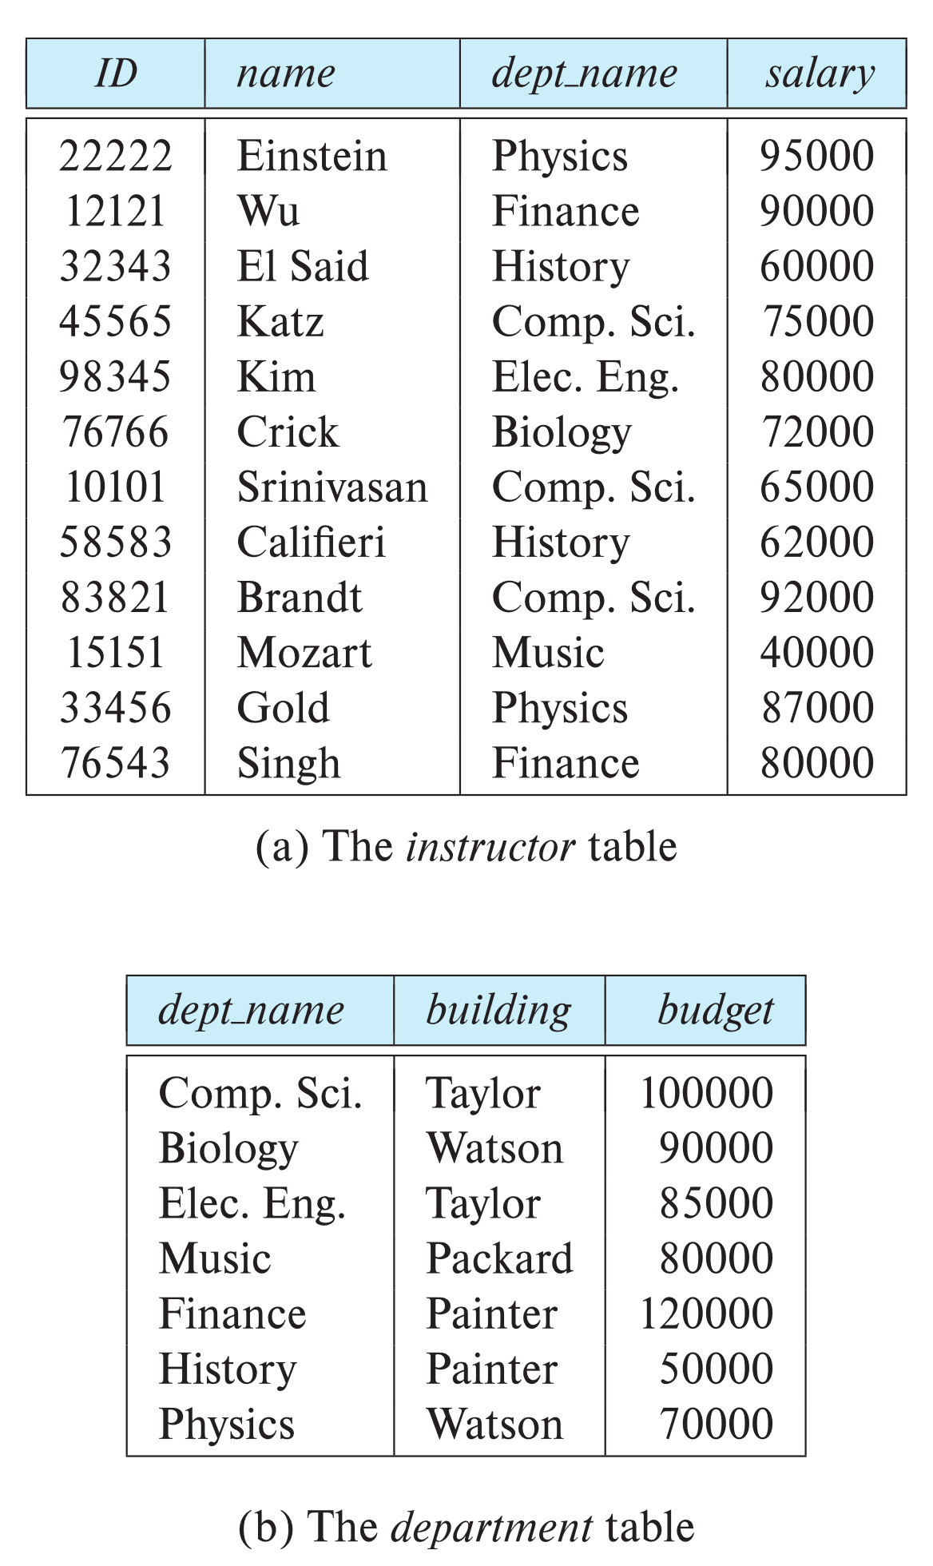

Relational Models
All the data is stored in various tables.
Example of tabular data in the relational model
Columns
Rows
Ted Codd
Turing Award 1981

Slide 13
Sample Relational Models

Slide 14
Network model
Collection of records connected to one another through links.
Each record is a collection of fields (attributes), contains only one data value.
A link is an association between precisely to records

Slide 15
type customer = record
customer_name: string;
customer_ street: string;
customer_city : string;
end;
type account = record
account_no: string;
balance: integer;
end;

Slide 16
Hierarchical Model
Organizes data into a tree-like structure, where each record has a single parent or root.
Hierarchical database is a collection of record that is connected to each other through links.
A record is similar to a record in the Network Model.

Slide 17
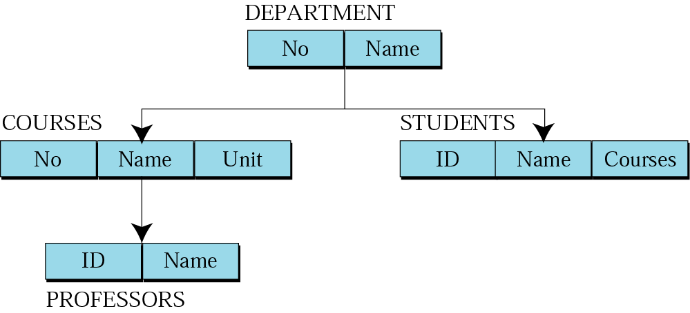
Data are organized in an upside down tree
Each entity has one parent and many children

Slide 18
Consider a database that represents a customer account relationship in a banking system. There are two records type CUSTOMER and ACCOUNT. CUSTOMER consists of customer_name, customer_street and customer_city. Similarly, the account record consists of two fields account_no and balance.

Slide 19
Data Structure Diagram
Representing the design of network database.
Consists of two basic components;
  Boxes: to record type
  Lines: links between the boxes.
Serve the same purpose of an ER diagram (logical structure)

Slide 20
ER-diagram
Data structure diagram

Slide 21
Levels of Abstraction
Physical level: describes how a record (e.g., instructor) is stored.
Logical level: describes data stored in database, and the relationships among the data.
  type instructor = record
  ID : string;
  name : string;
  dept_name : string;
  salary : integer;
        end;
View level: application programs hide details of data types. Views can also hide information (such as an employee’s salary) for security purposes.

Slide 22
View of the Data
An architecture for a database system

Slide 23
Instances and Schema
Similar to types and variables in programming languages
Logical Schema – the overall logical structure of the database
  Eg: The database consists of information about a set of customers and accounts in a bank and the relationship between them
Physical schema – the overall physical structure of the database
Instance – the actual content of the database at a particular point in time
  Analogous to the value of a variable

Slide 24
Physical Data Independence
The ability to modify the physical schema without changing the logical schema
Applications depend on the logical schema
In general, the interfaces between the various levels and components should be well defined so that changes in some parts do not seriously influence others.

Slide 25
Data Definition Language (DDL)
Specification notation for defining the database schema
        create table instructor (
            ID char(5),
            name varchar(20),
            dept_name varchar(20),
            salary numeric(8,2)
            )
DDL compiler generates a set of table templates stored in a data dictionary
Data dictionary contains metadata (i.e., data about data)
    Database schema
    Integrity constraints: Primary key
    Authorization

Slide 26
Data Manipulation Language (DML)
Language for accessing and updating the data organized by the appropriate data model
DML also known as query language
There are basically two types of data-manipulation language
  Procedural: require a user to specify what data are needed and how to get those data.
  Declarative: require a user to specify what data are needed without specifying how to get those data.
Declarative DMLs are usually easier to learn and use than are procedural DMLs.
Declarative DMLs are also referred to as non-procedural DMLs
The portion of a DML that involves information retrieval is called a query language.

Slide 27
SQL Query Language
SQL query language is nonprocedural.
Example to find all instructors in Comp. Sci. dept
        select name
        from instructor
        where dept_name = “Comp. Sci”
SQL is NOT a Turing machine equivalent language
Compute complex functions SQL is usually embedded in some higher-level language
Application programs generally access databases through one of
  Language extensions to allow embedded SQL
  Application program interface which allow SQL queries to be sent to a database

Slide 29
Database Design
The process of designing the general structure of the database:
Logical Design – Deciding on the database schema.
Business decision – What attributes should we record in the database?
Computer Science decision – What relation schemas should we have and how should the attributes be distributed among the various relation schemas?
Physical Design – Deciding on the physical layout of the database

Slide 30
Database Engine
A database system is partitioned into modules to deal with system’s responsibilities
The functional components of a database system can be divided into
The storage manager,
The query processor component,
The transaction management component.

Slide 31
Storage Manager
A program module that provides the interface between the low-level data stored in the database and the application programs and queries submitted to the system.
The storage manager is responsible to the following tasks:
  Interaction with the OS file manager
  Efficient storing, retrieving and updating of data
  The storage manager components include:
      Authorization and integrity manager
      Transaction manager
      File manager
      Buffer manager

Slide 32
Storage Manager
The storage manager implements several data structures as part of the physical system implementation:
Data files: store the database itself
Data dictionary: stores metadata about the structure of the database,
Indices: can provide fast access to data items

Slide 33
Query Processor
The query processor components include:
DDL interpreter : interprets DDL statements and records the definitions in the data dictionary.
DML compiler: translates DML statements in a query language into an evaluation plan consisting of low-level instructions that the query evaluation engine understands.
Query evaluation engine: executes low-level instructions generated by the DML compiler.

Slide 34
Query Processor

Slide 35
Transaction Management
A transaction is a collection of operations that performs a single logical function in a database application
Transaction-management: component ensures that the database remains in a consistent (correct) state despite system failures
Concurrency-control manager: controls the interaction among the concurrent transactions, to ensure the consistency of the database.

Slide 36
Database Architecture
Centralized databases: One to a few cores, shared memory
Client-server: One server machine executes work on behalf of multiple client machines.
Parallel databases: Many core shared memory, Shared disk, Shared nothing
Distributed databases: Geographical distribution, Schema/data heterogeneity

Slide 37
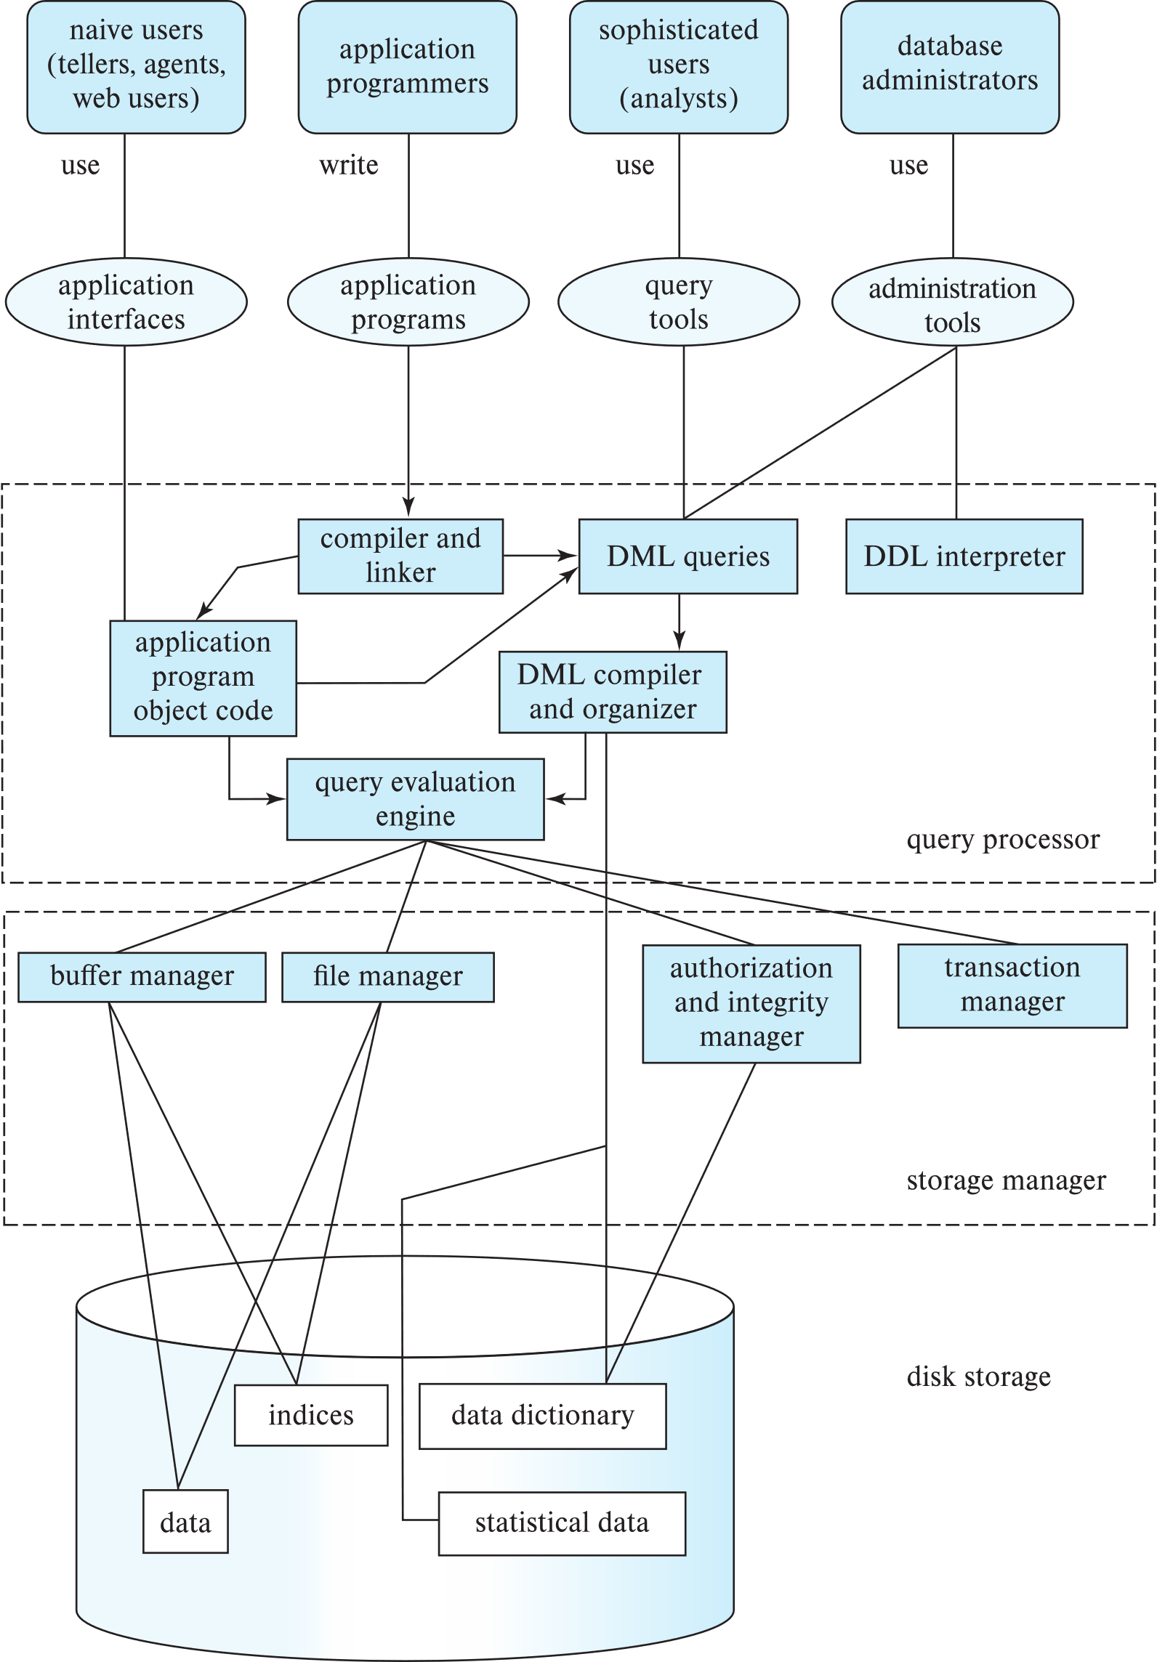
Database Architecture

Slide 38
Database Applications
Database applications are usually partitioned into two or three parts
Two-tier architecture: the application resides at the client machine, where it invokes database system functionality at the server machine
Three-tier architecture:
  The client machine acts as a front end and does not contain any direct database calls.
  The client end communicates with an application server, usually through a forms interface.
  The application server in turn communicates with a database system to access data.

Slide 39
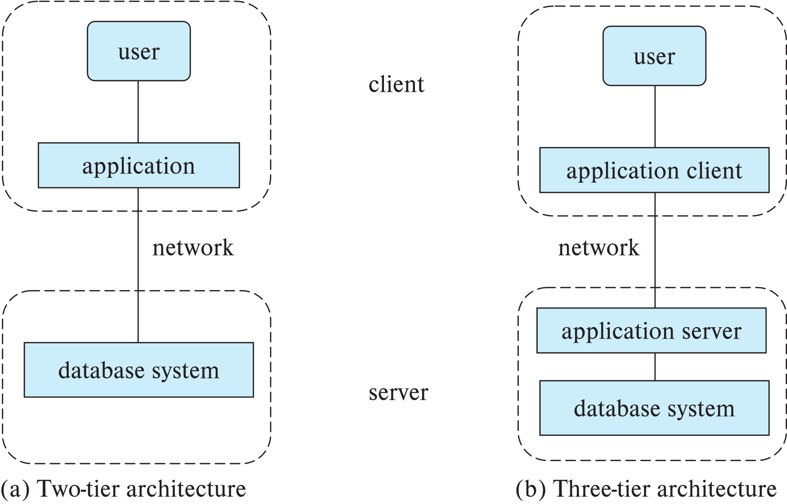
Database Applications

Slide 40
Database Users

Slide 41
Database Administrator
A person who has central control over the system
Functions of a DBA include:
Schema definition
Storage structure and access-method definition
Schema and physical-organization modification
Granting of authorization for data access
Routine maintenance
Periodically backing up the database
Ensuring that enough free disk space is available
Monitoring jobs running on the database

Slide 42
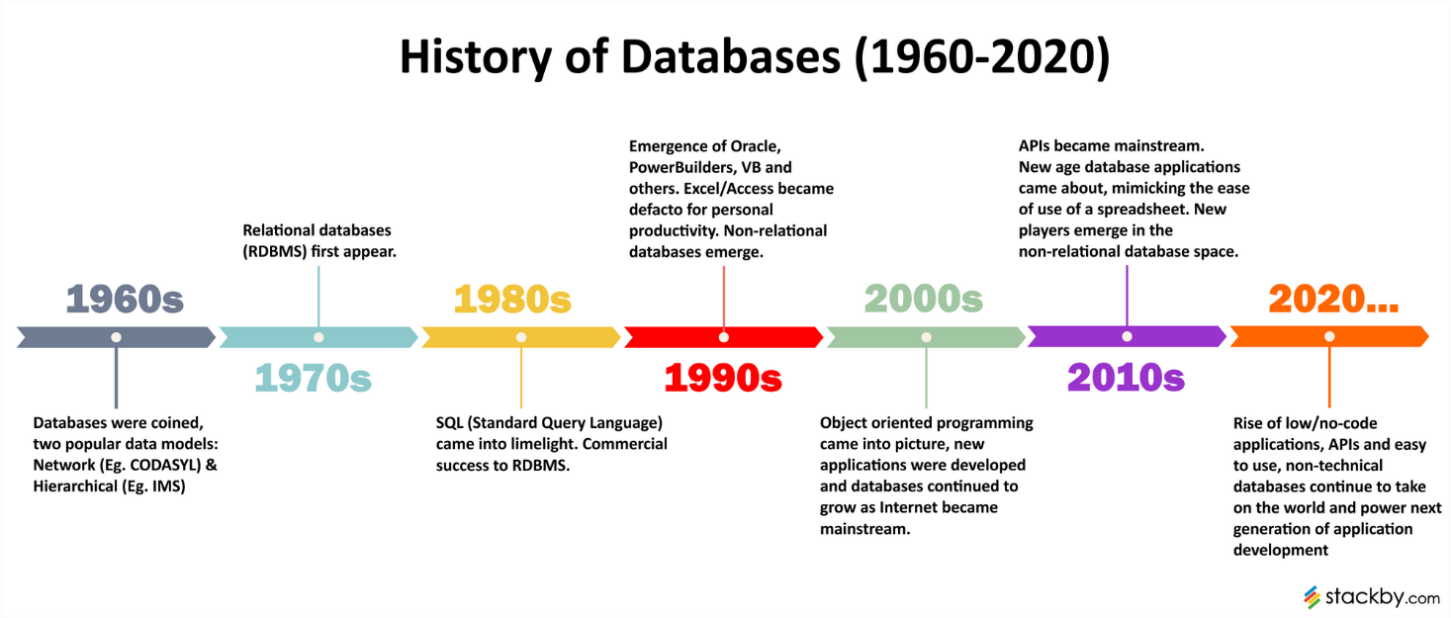
History of Database Systems

Slide 43
History of Database Systems
1950s and early 1960s:
  Data processing using magnetic tapes for storage
  Tapes provided only sequential access
  Punched cards for input
Late 1960s and 1970s:
  Hard disks allowed direct access to data
  Network and hierarchical data models in widespread use

Slide 44
History of Database Systems
  Ted Codd defines the relational data model
    Would win the ACM Turing Award for this work
    IBM Research begins System R prototype
    UC Berkeley (Michael Stonebraker) begins Ingres prototype
  Oracle releases first commercial relational database
High-performance (for the era) transaction processing

Slide 45
History of Database Systems
  1980s:
    Research relational prototypes evolve into commercial systems
    SQL becomes industrial standard
    Parallel and distributed database systems
    Wisconsin, IBM, Teradata
    Object-oriented database systems
  1990s:
    Large decision support and data-mining applications
    Large multi-terabyte data warehouses
    Emergence of Web commerce

Slide 46
History of Database Systems
  2000s
    Big data storage systems
    Google BigTable, Yahoo PNuts, Amazon,
    “NoSQL” systems.
    Big data analysis: beyond SQL
    Map reduce and friends
  2010s
    SQL reloaded
    SQL front end to Map Reduce systems
    Massively parallel database systems
    Multi-core main-memory databases

